Slide 1
GoMArs
By Maya prado

Slide 2
User Stories
1. As an Earth inhabitant I am tired of living on this planet so I want to use GoMars app to find a suitable real estate on Mars;
2. As a user I want to be able to see a street view of my new house on Mars and get information about my alien neighbors, their lifestyle and dietary preferences;
3. As a user I want to save houses to my wish list and be able to delete them from my wish list later;
4. As a user I want to be able to see the price of houses in different currencies;
5. As a user I want to be able to use some extra features that will make my experience with the app more pleasant. As an example - beautiful pictures related to space and Mars.

Slide 3
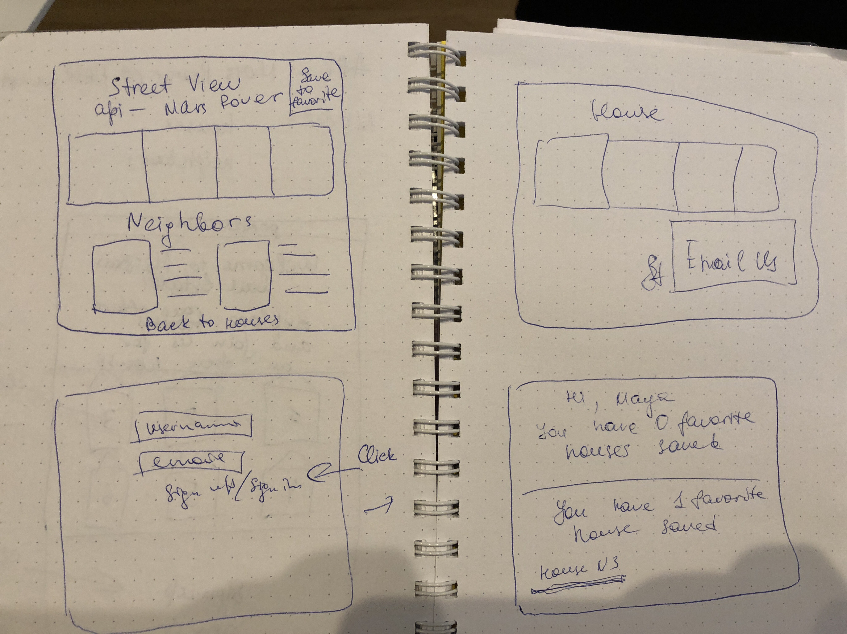
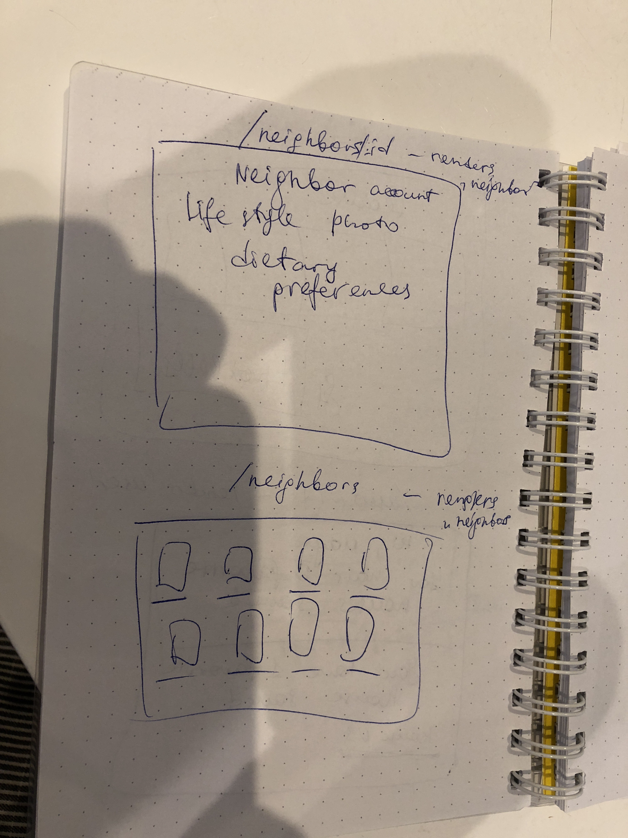
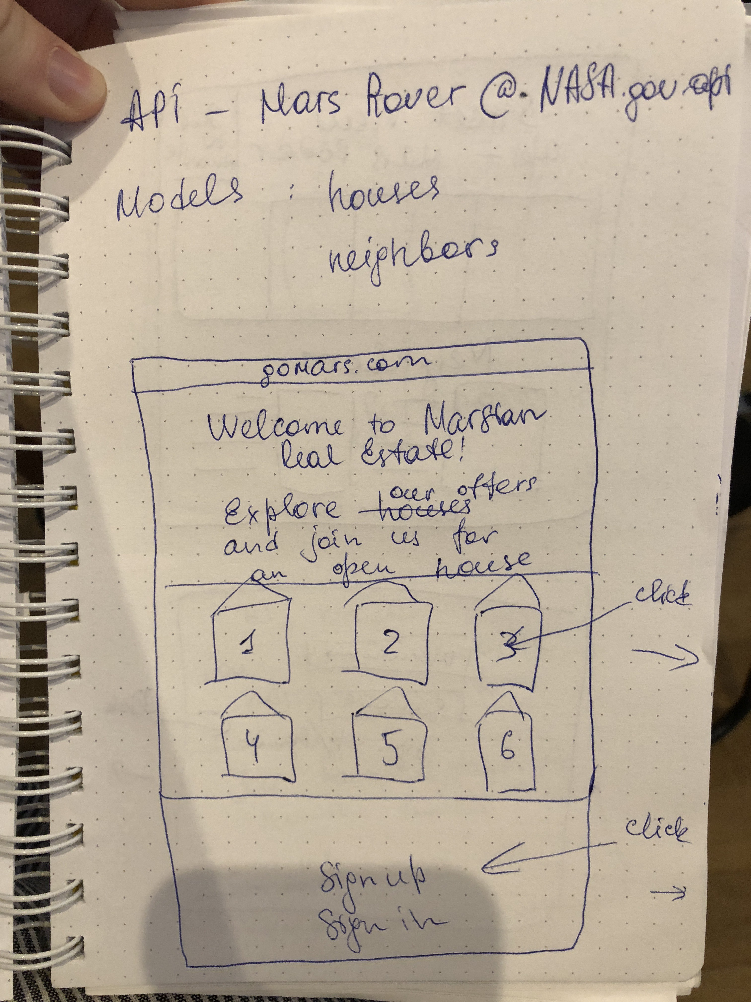
WIREFRAMES

Slide 4
EXTERNAL API: 1. NASA – rover Curiosity photos of mars 2. NASA – Picture of the day 3. Open exchange rates additional npm package: currency-converter

Slide 5
THANK YOU!
Link: https://go-mars.herokuapp.com/houses

